Slide 1


Slide 2
DEVELOPMENT OF COURIER MANAGEMENT SYSTEM CREATED BY US
Jyoti Ranjan Biswal (2004000629127030)
Debashish Das (2004000629127034)
Renubala Pradhan (2004000629127035)
Debasmita Sahoo (2004000629127028)

Slide 3

AIM OF THE PROJECT
Courier management system project is management software designed by considering various factors in courier billing system.
The proposed mobile app will help to manage customer information, package details, generate reports, billing. Mobile app have 3 users master admin, agent and user can track for courier status.
Courier management application will be a comprehensive and complete application will be able to manage all its operations of manage agent, tracking, billing, status count, print status and also the tracking and manage delivery info all registered consignments or packages, manage customer related information.
The mobile app provide necessary info to the same as will be send for both sender and receiver include status of booked package or consignment. User can track the courier through online site.

Slide 4
OBJECTIVE OF THIS PROJECT
The Application generally relates to Courier Management system and method to maintain transparency and efficiency in the delivery of goods through maintaining the Bill details.

Slide 5

SOFTWARE AND HARDWARE REQUIREMENTS
HARDWARE REQUIREMENTS:
Processor : Intel 3
Motherboard : Intel mother board – VTx Enabled
Ram : 4 gb
Hard disk drive : 500 gb
SOFTWARE REQUIREMENTS:
Front end : html5, css3, bootstrap
Back end : php, mysql
PHP Tools:
xampp-win32-5.5.19-0-VC11

Slide 6
EXISTING SYSTEM
Courier service is not complete until the dispatched parcel gets to the final recipient and the delivery report to sender. This service is best if it can be efficient in the three stages of the service, viz-a-viz: pre-courier, courier and post-courier activities. The pre-courier activities encompass all the preparatory actions taken before the dispatch of the parcel.
This includes identifying the courier agents/company, costing the service, specifying the delivery variables and registering the parcel for dispersal. The uncertainty of the costs of sending the package has become a big problem in the system.
There is need for clients to know how much it will cost them to send a package from the comfort of their home or offices before making any move so as to eliminate some untold disappointments.
The system will have the cost estimation capability using the parameters of date, time frame, weight, distance and delivery preference supplied by the clients thereby informing a potential user the cost of sending a particular package and the expected delivery date and time ahead of the initiation of the service proper.
There are associated stress and time wastage from the customers’ point of view in going to the courier office as well as waiting on the service queue just to send packages.

Slide 7
DISADVANTAGES OF EXISTING SYSTEM
Lack of privacy​
Risk in the management of the data.​
Less Security​
Low co-ordination between ​
Less User-friendly​
Accuracy not guaranteed​
Not in reach of distant users.
There is no storage and automation if users have some enquiry.

Slide 8

PROPOSED SYSTEM
The user’s participation in the courier service using the mobile application makes the meeting ground very efficient. The courier agent can easily seek for direction and redirection from either/both the sender or/and the recipient using the mobile app. This is the turning point in the user’s participation in courier service.
At some point in time, the courier agents can also use the app to easily locate a customer’s address with the aid of Google map API. This API assists courier agents navigating to their picking or delivery points.
At the final dispatch, both the recipient and sender can acknowledge the service completion using the mobile platform. This is regarded as the user’s participation in post-courier service.
In addition, It introduces a faster way to lay complain about a delay in delivery or missing package.
In this regards, fast means of communication between the customer and the agency is enhanced via virtualization of space using billing for both sender and receiver.

Slide 9
ADVANTAGES OF PROPOSED SYSTEM
Fast access.
Bill issued by procedure becomes fast.
Consignment note is easily generated by using preprinted stationary.
Manifest is prepared fast.
Better storage capacity.
Easy and fast retrieval of information.

Slide 10
MODULE LIST
USER
Register
Login
Track consignment number
View status
Print status

Slide 11
MODULE LIST
ADMIN
Login
New courier
View all courier details
Send – From to
Send delivery
Update/ delete courier
Create agent
Manage agent
Manage customer details
Status count
Download report for shipment

Slide 12
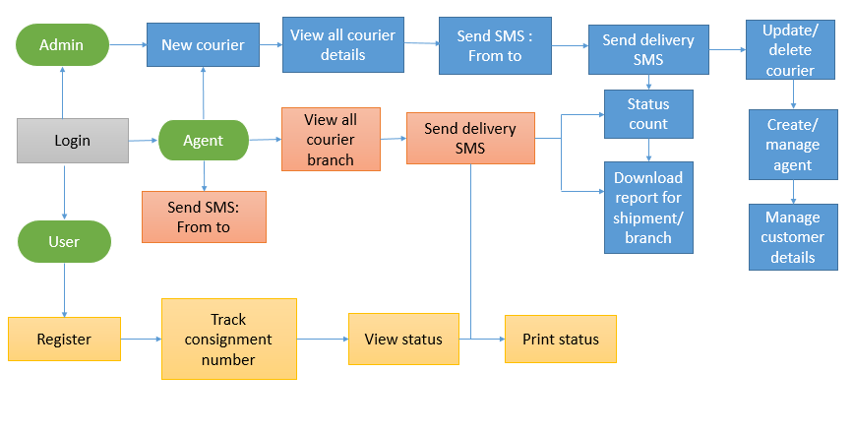
DIAGRAMS
ARCHITECTURE DIAGRAMS

Slide 13

USECASE DIAGRAMS
USER

Slide 14
USECASE DIAGRAMS
ADMIN

Slide 15
USECASE DIAGRAMS
AGENT

Slide 16
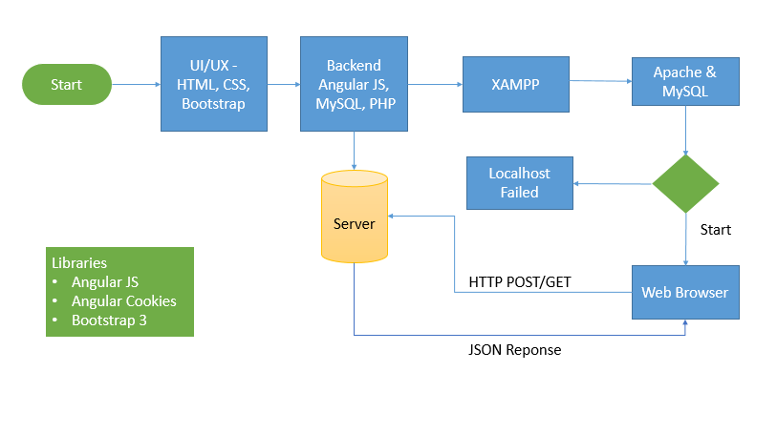
WORKFLOW DIAGRAM FOR WEB APPLICATION

Slide 17
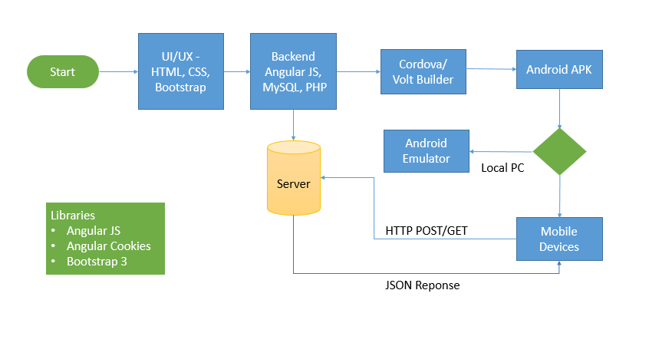
WORKFLOW DIAGRAM FOR ANDROID APPLICATION

Slide 18
CONCLUSION
This paper presents a mobile courier service system for the courier service sector in Nigeria. A critical look at the courier section in Nigeria shows that they are still far from using mobile device to support their operations, considering the enormous benefits of mobile applications in the global economy.
The system as developed provides an easier means to send documents and other package like laptops, books, etc. with less delay and stress. People do not have to visit the courier offices again for any reason.
The Mobile courier service system provided in this paper, when fully deployed, will help to improve the services rendered by courier companies in Nigeria.
So far, this system provides complete client side courier software which customers can use to send their package to various destinations By the resources available to us and considering the limitation, we were able to completely implement the client side of the mobile courier service system and we leave the rest as recommendation for further development.

Slide 19
FUTURE ENHANCEMENT
In Future work, This application to develop a cross platforms like IOS, etc.
In adding the more features Courier management application to develop access with user’s flexibility.
To authenticate the users based on the system users list which is maintained by the operating system
To restrict the usage of all files by the users based on their privileges on the system

Slide 20
REFERNECES
Azeta, A. A., Ogunlana A. O. and Ezeh C. O., (2010) Design and Implementation of a Mobile Express Delivery System, Proceedings of the International Conference on Software Engineering and Intelligent Systems, Ota, Nigeria SEIS 2010. Vol 1.
Chauhan A., Singh S., Jain A. and Kumar R. (2010). High-Tech Courier Services as an E-Courier services in India Prospective. Report and Opinion 2010;2(5):86-93. ISSN:1553-9873.
Chris. (2006). Courier System report.
http://d1dlalugb0z2hd.cloudfront.net/highlight/pdfgenerator/courier.pdf
Emeje, S (2013) Many courier companies are going down, interview with Punch newspaper August,19.

